Slide 1


Machine Learning ‘TERMINOLOGIES’
Dr. Hemalatha
AmritaWNA
Amrita Vishwa Vidyapeetham
Notes:
https://www.amrita.edu/news/amrita-surya-vahini-solar-auto-rickshaw

Slide 2
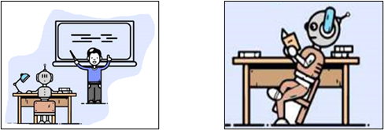
Supervised ML
In this type of learning, we use labeled datasets. These datasets are designed to train or control algorithms to classify data or accurately predict results. Using labeled inputs and outputs, the model can measure its accuracy and learn over time. Supervised learning allows us to collect data and produce a output from previous experiences.
https://medium.com/mlearning-ai/supervised-learning-vs-unsupervised-learning-vs-reinforcement-learning-a2a7d89b6a99

Slide 3
Unsupervised ML
Algorithms in unsupervised learning discover hidden patterns in data without the need for human intervention, so they are unsupervised. Where it is used:
Clustering: It is used to group unlabeled data according to their similarities or differences.
Association: To find the relationship between the variables in a particular data set; For example, the phrase “People who bought this product also bought this” we see while shopping.
https://pandian-shanthababu.medium.com/supervised-vs-unsupervised-learning-1f4f8d01bc6f

Slide 4
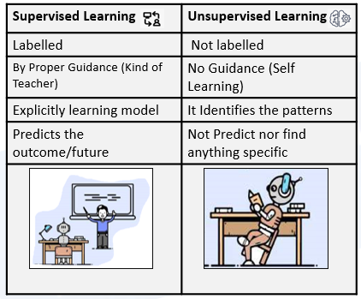
Supervised vs Unsupervised ML
https://pandian-shanthababu.medium.com/supervised-vs-unsupervised-learning-1f4f8d01bc6f

Slide 5
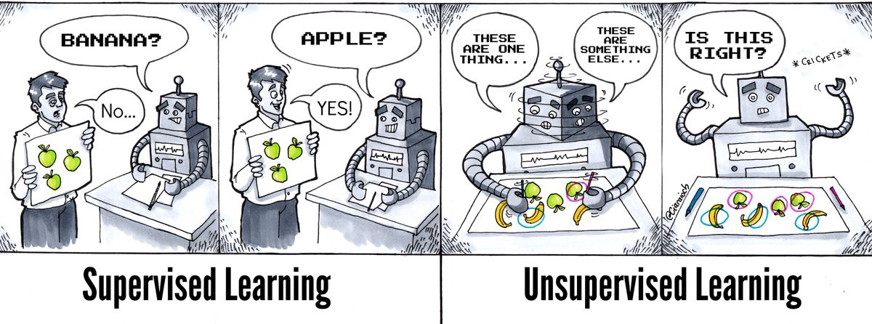
Supervised vs Unsupervised ML
https://pandian-shanthababu.medium.com/supervised-vs-unsupervised-learning-1f4f8d01bc6f

Slide 6
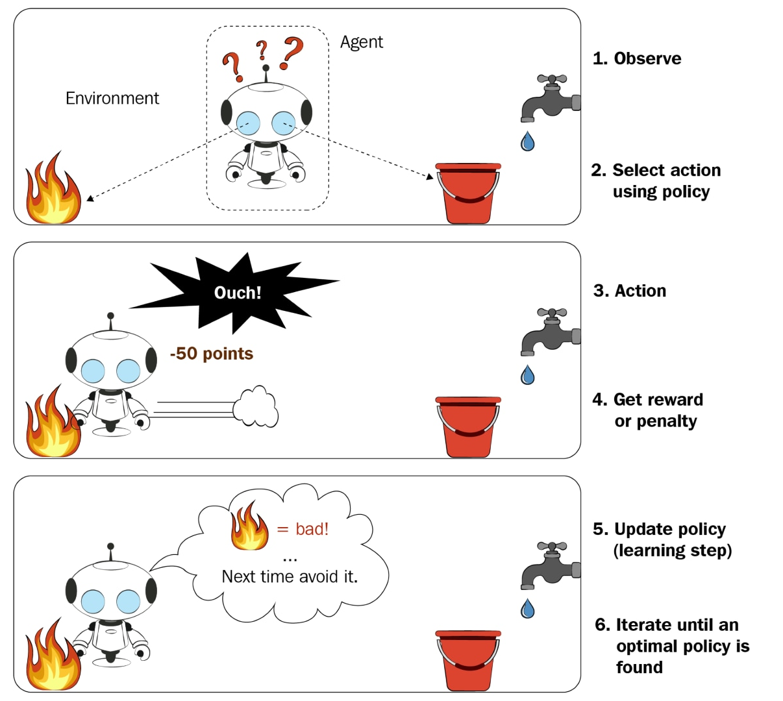
Semi supervised learning / Reinforcement learning
In this learning, the model simultaneously receives data and seeks feedback to explore learning. Because it makes learning active. That is, system needs a feedback signal to learn which of it’s actions are best or not. We can also say that it detects predicted errors by using a punishment or reward system.

Slide 7
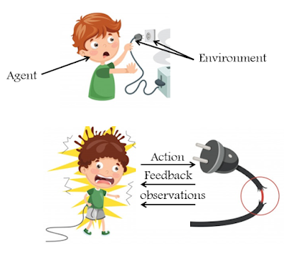
Semi supervised learning / Reinforcement learning

Slide 8
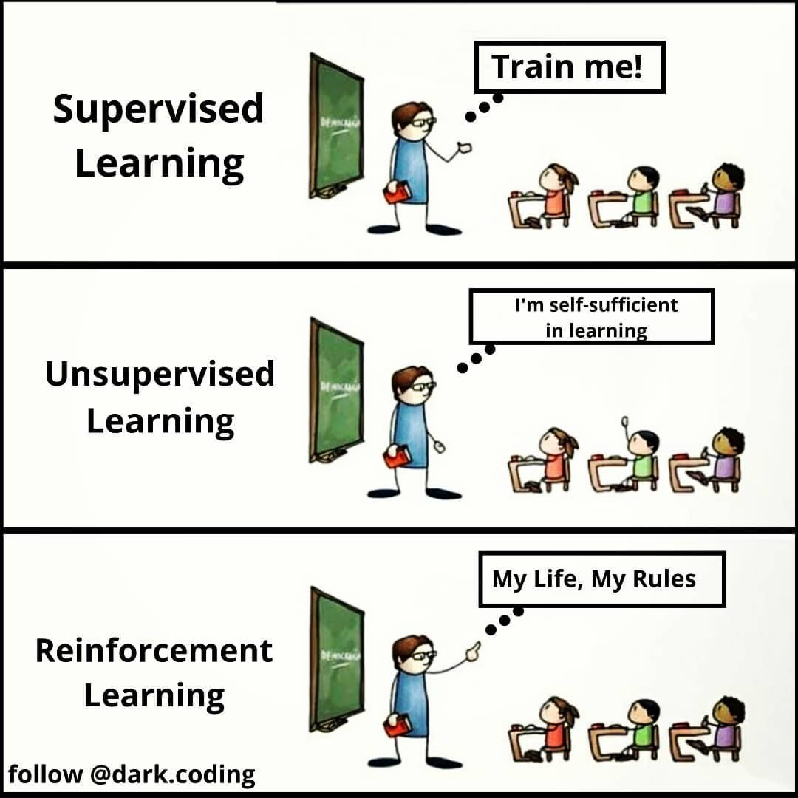
Just some humor

Slide 9
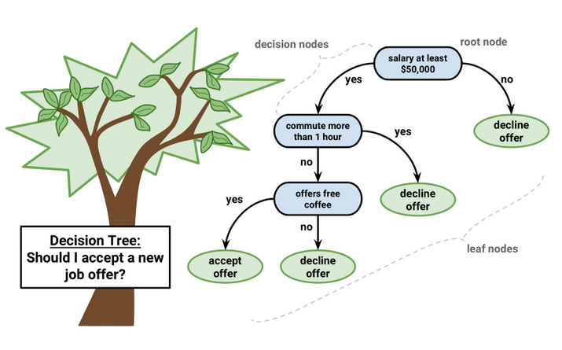
Classification
Classification is a part of supervised learning (learning with labeled data) through which data inputs can be easily separated into categories. In machine learning, there can be binary classifiers with only two outcomes (e.g., spam, non-spam) or multi-class classifiers (e.g., types of books, animal species, etc.).
One of the most popular classification algorithms is a decision tree (essential for both data scientists and machine learning engineers), whereby repeated questions leading to precise classifications can build an “if-then” framework for narrowing down the pool of possibilities over time.
Source: https://towardsdatascience.com/machine-learning-classifiers-a5cc4e1b0623

Slide 10
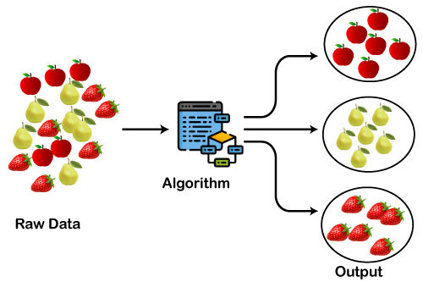
Clustering
"A way of grouping the data points into different clusters, consisting of similar data points. The objects with the possible similarities remain in a group that has less or no similarities with another group.“
Main clustering methods used in Machine learning:
Partitioning Clustering
Density-Based Clustering
Distribution Model-Based Clustering
Hierarchical Clustering
Fuzzy Clustering
https://www.javatpoint.com/clustering-in-machine-learning

Slide 11
Regression??
…
https://www.javatpoint.com/clustering-in-machine-learning

Slide 12
Thanks
Notes:
https://www.amrita.edu/news/amrita-surya-vahini-solar-auto-rickshaw

